Slide 1
NATIVE- POLYACRYLAMIDE GEL ELECTROPHORESIS

Slide 2
NATIVE PAGE
Native PAGE gels are also referred to as non denaturing gels meaning they are run in the absence of SDS.
It was the original mode of electrophoresis using PAGE gels.
The mobility of proteins on Native PAGE is dependent on protein charge as well as its hydrodynamic size. Hence based on mass to charge ratio.
It therefore not only provide important information such as protein size but does provide information on protein charge as well as sub-unit composition.
It is also important because it can separate proteins of identical molecular weight that are usually hard to resolve effectively using SDS-PAGE

Slide 3
NATIVE PAGE
Native gels because they are run under non denaturing condition have proteins that do not lose their original shape and activity. The protein retains its folded conformation.
It is carried out near neutral pH to avoid acid or alkaline denaturation of protein.
It contains both the separating and stacking gel but the stacking gel here mostly is important for enhancement of the resolution of separated components. The only difference in the preparation of non denaturing polyacrylamide gel and SDS PAGE is the fact that SDS is excluded. Mercaptoethanol is also not utilized. Samples are also not boiled.
Therefore, native gels are sensitive to any process that alter the charge or the conformation of the protein.

Slide 4
NATIVE PAGE
Interpretation of Native PAGE is more complex than that of SDS-PAGE gels.
Differences in relative mobility can reflect differences in charge, mass as well as both.
It is not easy to understand what makes one protein migrate faster than the other as it could be a larger number of electric charges, a smaller size or even a more spherical shape. Hence this is the reason that SDS-PAGE gels are run often as they separate proteins based on single molecular property making interpretation much easier.

Slide 5
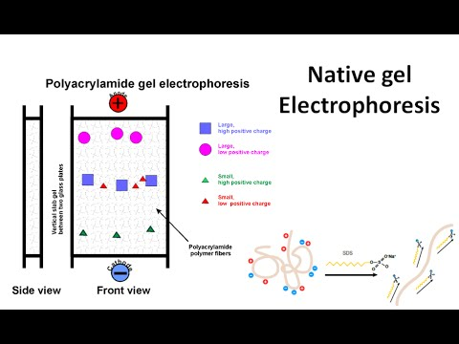
NATIVE PAGE

Slide 6
NATIVE PAGE
It is extremely important when identifying a protein in the gel by its biological activity such as enzyme activity, receptor binding, antibody binding.
In this case when purifying for example an enzyme it appears as a single band but however this could still be inaccurate and hence to confirm that its is really the enzyme that has been isolated enzyme activity of the band can be determined.
These gels allow the detection of enzymes separated through their sensitivity and specific activity stains but this is limited to enzymes for which chromogenic and chemiluminescent assays exist.

Slide 7
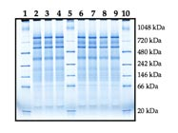
NATIVE PAGE

